Slide 1
Lecture 18 October 16, 2019
Exam 2 Returned Friday, if possible.
Tomorrow—Lab on Human traits. Should be time to do some Drosophila work.

Slide 2
https://www.nobelprize.org
It’s Nobel Prize week!!!
Prize in Medicine and Physiology-—3 scientists who study hypoxia. Low oxygen.
Nobel Prize in Physics—For discovery of first planet orbiting a star in a solar system outside our own.
Nobel Prize in Chemistry—for development of lithium-ion batteries. Thank them when recharging ANYTHING today.

Slide 3
Next week will discuss…
Literature---Olga Tokarczuk (Poland) and Peter Handke (Austria)
Peace---Abiy Ahmed Ali (Ethiopian prime minister)---Peace between Ethiopia and Eritrea—border initiative
Economic Sciences Abhijit Banerjee, Esther Duflo, Michael Kremer--for their experimental approach to alleviating global poverty

Slide 4
Where were we?....
Extensions of Mendel’s observations…
#3 Co-dominance For some traits, heterozygotes express different alleles equally
#4 Genes with multiple (2+) alleles

Slide 5
ABO blood group antigens
Antigen used commonly to determine common “ blood type”
Example of 2 extensions of Mendel’s observations.
1. Co-dominance (and complete dominance)
2. Trait controlled by a gene with 3 alleles in the population. Gene is called isoagglutinogen gene.

Slide 6
Summarize Genotypes and Phenotypes
Genotype Gene product Phenotype/Blood type
I^{A}I^{A} A sugar/antigen A
I^{A}I^{O} A sugar/antigen A
I^{B}I^{B} B sugar/antigen B
I^{B}I^{O} B sugar/antigen B
I^{A}I^{B} A and B sugar/antigen AB
I^{O}I^{O} neither A nor B sugar/antigen O

Slide 7
Test your understanding. What type of offspring are possible? What are theoretical expectations? Do this! Practice! Show Punnett square!
AXA
B X B
A X B
O X O
AB X AB
A X O
B X O
A X AB
B X AB
O X AB
Set up your punnett square in ways that test all possibilities of genotypes.

Slide 8
Practical application?...
Blood type is often used to determine if an individual could be the parent of a child.
e.g. Paternity cases, babies switched in hospital
Can only rule out an individual as a parent, not prove that he/she is. Why?

Slide 9
Why do we care about ABO blood group?
Until medical technology advanced to allow blood transfusions, we didn’t care, because hadn’t detected them yet.
But…During the first transfusions, ABO antigens were actually discovered because agglutination occurred in the recipient of the donated blood cells. Agglutination in vivo is fatal.

Slide 10
So…what happened?
Some immunology background….Usually white blood cells called B-cells produce antibodies only after something foreign enters our bodies---like a virus.
e.g. Vaccines—like the influenza virus shot uses killed or inactivated forms of viruses.
Antibodies are very specific and bind the foreign antigen to inactivate it. (Influenza virus will cause some B-cells to make anti-flu antibodies)

Slide 11
But why would humans have anti-A, and/or anti-B antibodies in their serum?
Unusual phenomenon. Humans make anti-A and anti-B antibodies without known prior exposure to the antigens.
Cause rbcs to agglutinate (clump together)
Fatal in blood transfusions with incompatible blood types

Slide 12
Summary of all blood types
Blood type rbc antigen antibody produced result as transfusion recipient
A A anti-B agglutinates B RBCs
B B anti-A agglutinates A RBCs
AB A and B none no agglutination
O no A nor B anti-A and anti-B agglutinates A, B, AB RBCs

Slide 13
Blood type compatibility---practice!
Must consider 2 things before blood transfusions
Which, if any antigens are on the rbcs of the donor? (Donor only gives cells)
Which, if any antibodies will be present in the recipient's serum. (donors cells will combine with the recipient’s serum)

Slide 14
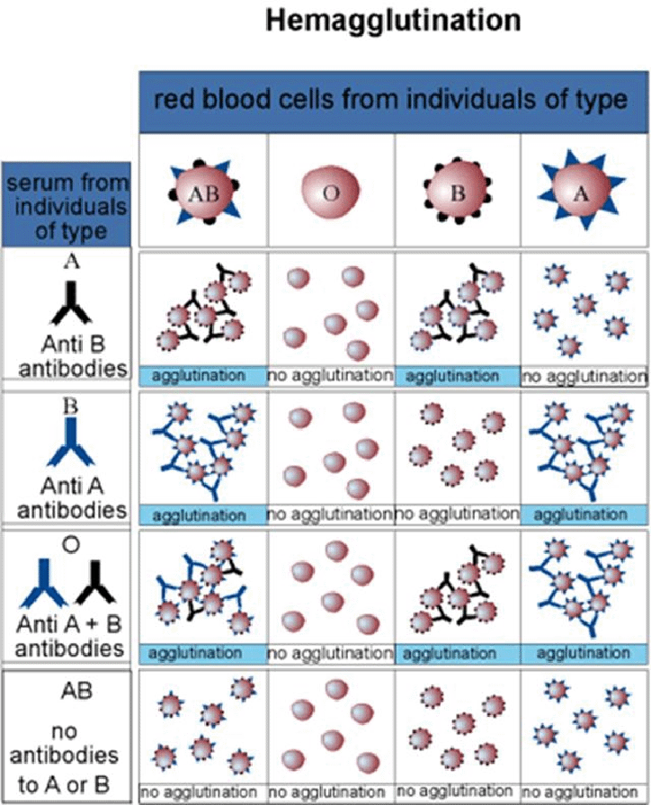

Slide 15
Try the blood typing game at: Nobelprize.org
http://www.nobelprize.org/educational/medicine/bloodtypinggame/

Slide 16
Other important rbc antigens…
Another antigen, called D-antigen/rhesus factor/Rh factor is present on rbcs
Controlled by other genes (not I-gene)
Some people express Rh antigen on rbcs (Rh-positive), some lack the antigen (Rh-negative)
Important in women during pregnancy
Fatal condition for fetus in cases of Rh incompatibility

Slide 17
Rh incompatibility
Rh-negative mother conceives an Rh-positive child.
Normally blood from fetus and mother never comes in direct contact because of the placenta
At birth, however, placenta often ruptures and fetal rbcs may enter the mother’s circulation
Mother, who lacks Rh antigen sees it as “foreign” and begins to make anti Rh-antibodies. These antibodies can lyse/destroy rbcs with Rh antigen on them.

Slide 18
No problem?...
The baby is born…no problem for that baby.
Subsequent pregnancies---Rh+ fetuses will produce rbcs with Rh antigen. Mother will now have ability to make antibodies and destroy these cells.
Hemolytic anemia of the newborn. Fatal.

Slide 19
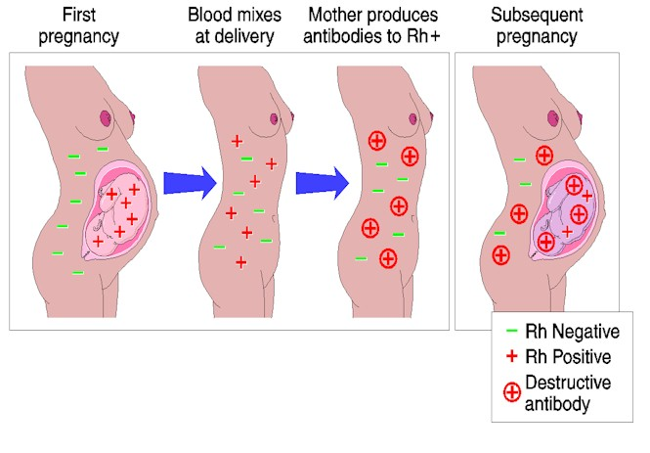

Slide 20
Solution?...
Now can give Rh- mother a substance Rhogam that lyses and destroys any Rh+ fetal cells from the baby before mother can mount her own antibody response.
What is the substance? Dose of anti-Rh antibodies. Seek out baby’s cells and destroy, but do not last long enough to affect a second pregnancy.

Slide 21
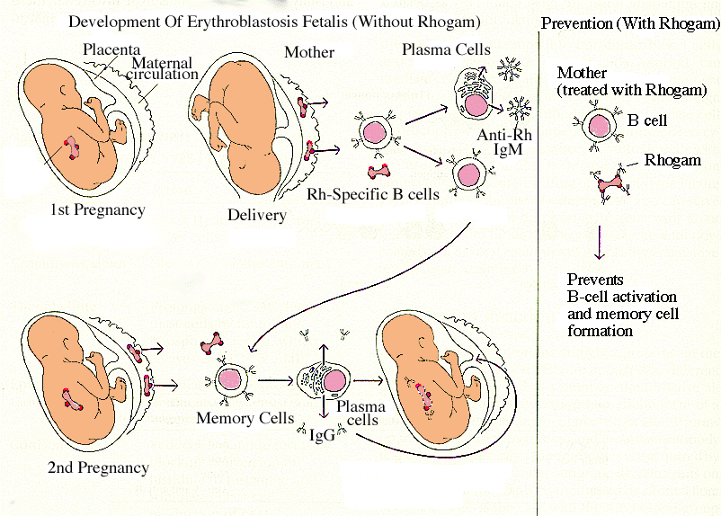
Destroys fetal cells before Mother’s B-cells are activated and begin making antibodies

Slide 22
Beyond this class…
You will find many post graduate tests include some questions that test your understanding of blood type genetics and blood type compatibility…Many graduates report the importance of committing this info to memory! (Commit the concept to memory so it can be applied to future questions).

Slide 23
(more) Extension #4
Genes with multiple alleles (examples)
I gene (A, B, O) alleles
White gene (locus) in Drosophila (100+ alleles which give variation to the wild-type (brick red) color). Variation at this gene gives possibility of many different eye colors/patterns.

Slide 24
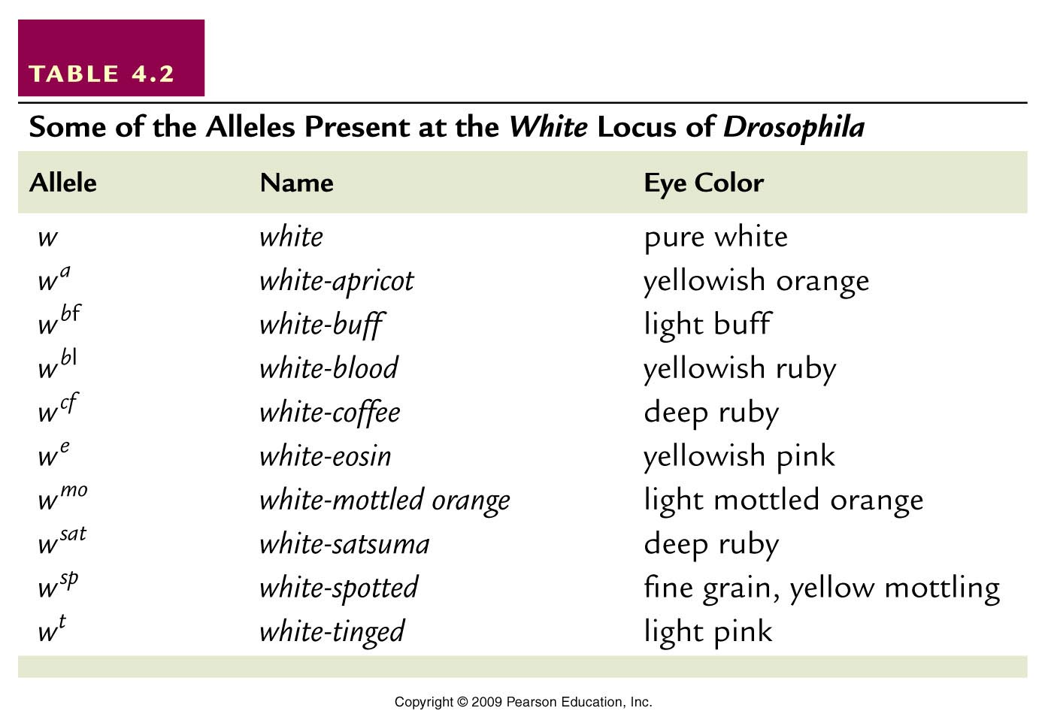
Table 4.2
Notes:
Table 4.2 Some of the Alleles Present at the white Locus of Drosophila

Slide 25
White-apricot, white-blood, white-eosin

Slide 26
What is happening at the molecular level?…
Drosophila chromosome 4/(X)
White gene locus
Gene has been altered (mutated ) multiple times over time, resulting in many variations in a protein that controls eye color.
X

Slide 27
A gene in mammals also shows 100s of alleles
Major histocompatability complex (MHC)
Gene encoding a protein needed for immune responses.
Shows such variability to allow the population to effectively deal with many pathogens
Gene is so variable (polymorphic) that few unrelated people share the same MHC genotype. (Virtually everyone is a heterozygote).

Slide 28
Why do we care about MHC?...
Important in normal immunity
We have discovered it is reason that tissue transplants fail. Some MHC proteins must be identical for the recipient to accept donated tissue.
“tissue match” is really MHC match.
Why do we often arrange tissue transplants with family members?...

Slide 29
Think of just one MHC gene Theoretically, you could match your siblings. You have a 25% chance of matching one of your siblings (4 unique genotypes).

Slide 30
The need for unrelated donors…for organs, including bone marrow (upcoming bone marrow registry drive)

Slide 31
Extension #5
Lethal alleles
In some matings we may see non-Mendelian ratios if some of the offspring fail to survive development.

Slide 32
Indicates that the gene in question encodes something essential for survival

Slide 33
noted in an interesting cross of mice with variation in fur color…
Wild type color= agouti (yellow pigment deposited on a black hair shaft)
Wild type allele=A
Dominant mutation (A^{y}) results in yellow fur.
What do you expect in a cross of 2 yellow mice (heterozygotes)? A A^{y} X A A^{y}

Slide 34
 | A | A^{y}
A | AA | AA^{y}
A^{y} | AA^{y} | A^{y}A^{y}
Expect?...3 yellow: 1 agouti

Slide 35
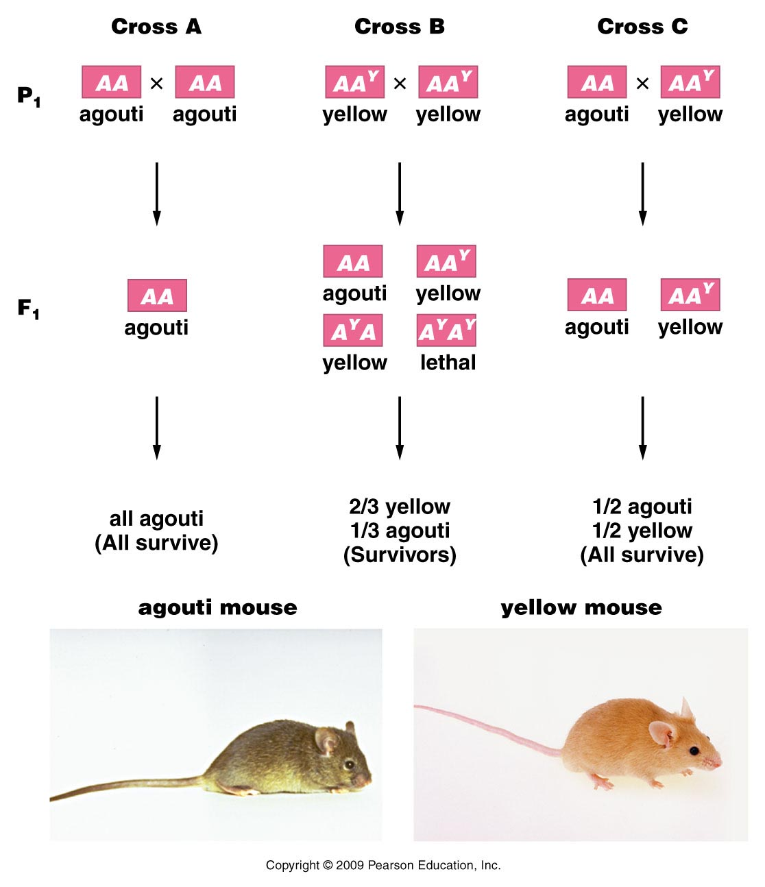
Figure 4.4
Notes:
Figure 4-4 Inheritance patterns in three crosses involving the normal wild-type agouti allele (A) and the mutant yellow allele (A^{Y}) in the mouse. Note that the mutant allele behaves dominantly to the normal allele in controlling coat color, but it also behaves as a homozygous recessive lethal allele. The genotype A^{Y} A^{Y} does not survive.

Slide 36
observe~2 yellow:1 agouti
Explanation…looks like the A^{y} A^{y} genotype which we expect to be yellow, is also a lethal genotype.
(A^{y} is called a recessive lethal allele). Mice with this genotype die before they are born. They are not observed in the offspring.

Slide 37
Molecular mechanism?...
Nothing to do with yellow fur!
Y mutation/allele is really a large deletion of a chromosome region (which affects regulation of yellow pigmentation)
AND.. which affects the nearby gene called merc. The merc gene product is essential for normal development—so in A^{y} A^{y} mice, the wild type merc alleles are lost in both chromosomes.

Slide 38
Lethal alleles…
Can be recessive or dominant
Recessive A^{y} A^{y}
Dominant (Huntington allele) Hh—get Huntington disease and eventually die from it
Can be expressed before or after birth (A^{y} A^{y} is embryonic lethal; Hh is lethal in adulthood)

